Slide 1
Corn Leaf Disease Classification Using Deep-Ensemble-Learning
Team_No: AIE_13 Panel Number: Panel 07
Project Advisor:
Mr.Niranjan D K / Lecturer / CSE Dept
S.No | Reg.No | Name of the Student | Section
1 | BL.EN.U4AIE19028 | K.Vishnu Sainadh | AIE A
2 | BL.EN.U4AIE19034 | K.Satwik | AIE A
3 | BL.EN.U4AIE19066 | V.Ashrith | AIE A

Slide 2
Problem Definition
Developing deep learning models to distinguish between healthy and various unhealthy corn plant leaves.
Implement multiple deep learning models and combine them to form a deep ensemble model.
In this work, a new classification model will be proposed to accurately classify corn leaves infected with gray leaf spot, common rust, northern leaf blight, and healthy leaves from digital images.

Slide 3
Introduction
Corn is one of the most widely grown crops in the world, providing food, feed, and fuel to a large portion of the global population.
However, its growth and yield can be severely impacted by various diseases, such as leaf blight, northern leaf spot, and southern rust, among others.
In the agriculture sector, traditional methods of detecting plant diseases manually require experts to perform visual inspection and later more in-depth detection in labs which is time-consuming and not always available for smallholder farmers.
To mitigate the negative effects of these diseases, early and accurate diagnosis is crucial.

Slide 4
Literature Survey
S. | Authors | Full title of the | Inference from the | Open Problem
NO | name(s) | paper with Year | paper (based on
 |  |  | methodology,
 |  |  | technology)
1 | Z. Liu, Z. Du, Y. Peng, M. Tong, X. Liu and W. Chen | Study on Corn Disease Identification Based on PCA and SVM (ITNEC 2020 IEEE) | Otsu, OpenCV, and morphological transformation methods are used for image segmentation. PCA and SVM are applied to processed image. | Dataset is reduced in dimension and has not achieved high accuracy.
2 | T. Ren, Y. Zhang and C. Wang | Identification of Corn Leaf Disease Based on Image Processing (ICISCAE 2019 IEEE) | The system preprocess the corn leaf disease image, extract 11 shape and texture features to produce the ideal feature subset, and use the SVM method to create the recognition model. | Used a high-quality image dataset and achieved 89% test accuracy

Slide 5
Literature Survey
S. | Authors | Full title of the | Inference from the | Open Problem
NO | name(s) | paper with Year | paper (based on
 |  |  | methodology,
 |  |  | technology)
3 | H. Yu et al | Corn Leaf Diseases Diagnosis Based on K-Means Clustering and Deep Learning (IEEE Access 2021) | To identify three diseases, They used K-means technique to cluster sample photos and then feed them into the enhanced deep learning model. | Used brute force for finding optimal K value which is time taking

Slide 6
Literature Survey
S. | Authors | Full title of the | Inference from the | Open Problem (for
NO | name(s) | paper with Year | paper (based on | your proposed work)
 |  |  | methodology,
 |  |  | technology)
4 | W. Wenxuan, W. Qianshu, H. Chaofan, S. Xizhe, B. Ruiming and T. T. Toe | Leaf Disease image classification method based on improved convolutional neural network (ICIAT 2022 IEEE) | Proposed Model is VGG16. The model was iterated and compiled through a series of pre-processing of the images including keras ImageDataGeneartor, and the accuracy of the model was evaluated. | Classifying Healthy correctly other classification is poor and average of 93%. Missed Dataset balancing
5 | A. Baliyan, V. Kukreja, V. Salonki and K. S. Kaswan | Detection of Corn Gray Leaf Spot Severity Levels using Deep Learning Approach (ICRITO 2021 IEEE) | Collected real time dataset & preprocessed it and enhanced in terms of brightness and color contrast for uniformity and proposed DL Model | Only Severity Level of Gray Leaf Spot is detected but not other types of disease. Less Data is used to train Model. Data Augmentation is not done. Less accurate nearly 94%

Slide 7
Literature Survey
S. | Authors | Full title of the | Inference from the | Open Problem (for
NO | name(s) | paper with Year | paper (based on | your proposed work)
 |  |  | methodology,
 |  |  | technology)
6 | Rongjie Hu, Shan Zhang, Peng Wang, Guoming Xu, Daoyong Wang, and Yuqi Qian | The identification of corn leaf diseases based on transfer learning and data augmentation (CSSE 2020) | Proposed a convolutional neural network combined with transfer learning to identify corn leaf disease models. obtained their model by fine tuning the GoogLeNet pre-training network, adjusting parameters such as optimizer and learning rate. | Deep ensemble models are not used and only 500 images were used as part of the experiment
7 | Jamadagni, Prannov and Patil, Shriranjan and Grandhi, Pranay Eswar and Verma, Sourabh Singh | COVID-19 and Pneumonia classification Using Ensembling with Transfer Learning (ICRITO 2022 IEEE) | The Chest X-Ray images were classified with the help of transfer learning using VGG16, DenseNet, and MobileNet. To ensure better results Ensemble Learning is incorporated to provide better results and performance. | The training accuracy and validation accuracy had a gap which may be sign of overfitting and the performance difference was less.

Slide 8
Literature Survey
S. | Authors | Full title of the | Inference from the | Open Problem (for
NO | name(s) | paper with Year | paper (based on | your proposed work)
 |  |  | methodology,
 |  |  | technology)
8 | Yin C, Zeng T, Zhang H, Fu W, Wang L, Yao S | Maize Small Leaf Spot Classification Based on Improved Deep Convolutional Neural Networks with a Multi-Scale Attention Mechanism (Agronomy 2022) | Proposed the DISE-net deep learning architecture, created a dilated inception module to boost performance, and conducted comparative analysis with other networks, however DISE-net produced the best results. | This study does not consider the identification of multiple maize diseases
9 | Fraiwan M, Faouri E, Khasawneh N. | Classification of Corn Diseases from Leaf Images Using Deep Transfer Learning (MDPI 2022) | Proposed Transfer learning using well-established and well-designed deep learning models and the experiments were repeated 10 times to account for variability in picking random choices and got the mean accuracy of 98.6% | The dataset is of less number of images.

Slide 9
Literature Survey
S. | Authors | Full title of the | Inference from the | Open Problem (for
NO | name(s) | paper with Year | paper (based on | your proposed work)
 |  |  | methodology,
 |  |  | technology)
10 | Haque, Md & Adolphs, Julian | Corn Leaf Disease Classification and Detection using Deep Convolutional Neural Network (2021) | proposed two models - vgg block model for classification and YOLOv4 for the detection | the detection model achieves 55.30% accuracy
11 | Priyadharshini, R. & Selvaraj, Arivazhagan & Madakannu, Arun & Mirnalini, Annamalai | Maize leaf disease classification using deep convolutional neural networks (2019) | proposed a CNN based architecture - modified LeNet and it achieved an accuracy of 97.89% | The experiments are carried out with lesser number of images

Slide 10
Summary of Literature Survey
The dataset does not appear to be properly balanced, resulting in poor performance for certain classes or types of diseases. Balancing the dataset by ensuring an equal representation of different classes can help improve classification accuracy.
The dataset used for training and testing the models is relatively small, consisting of only 500 images. This limited amount of data may not provide enough variability and generalization capability for accurate classification.
The achieved accuracy is not high, ranging from 55.30% to 94%, indicating room for improvement in the classification performance.
Data augmentation techniques, which can artificially increase the size and diversity of the dataset, have not been employed. Augmentation methods like rotation, flipping, or scaling can help improve model robustness and generalization.

Slide 11
Software/Tools Requirements
Software
Python 3.0 or higher – Back End
Jupyter Notebook, Colab
Tensorflow
Hardware
Windows 10 or higher
I5 processor or higher
Ram 8 GB - Minimum

Slide 12
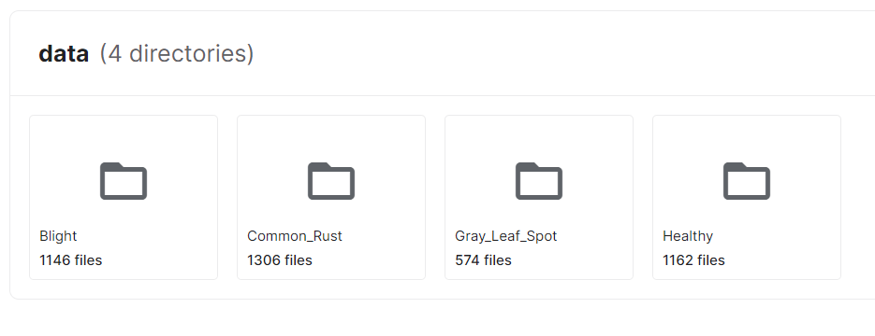
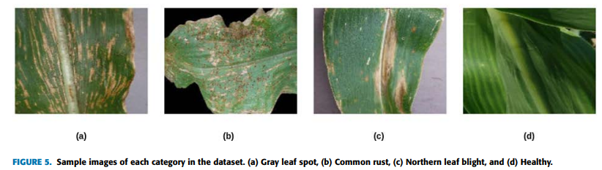
Data Set
Source of data set: Corn or Maize Leaf Disease Dataset (Link)
Sample data set
This dataset contains different diseases of corn leaves for identifying whether the plant is healthy or not. Although the dataset has less number of images we use data augmentation to train the model.

Slide 13
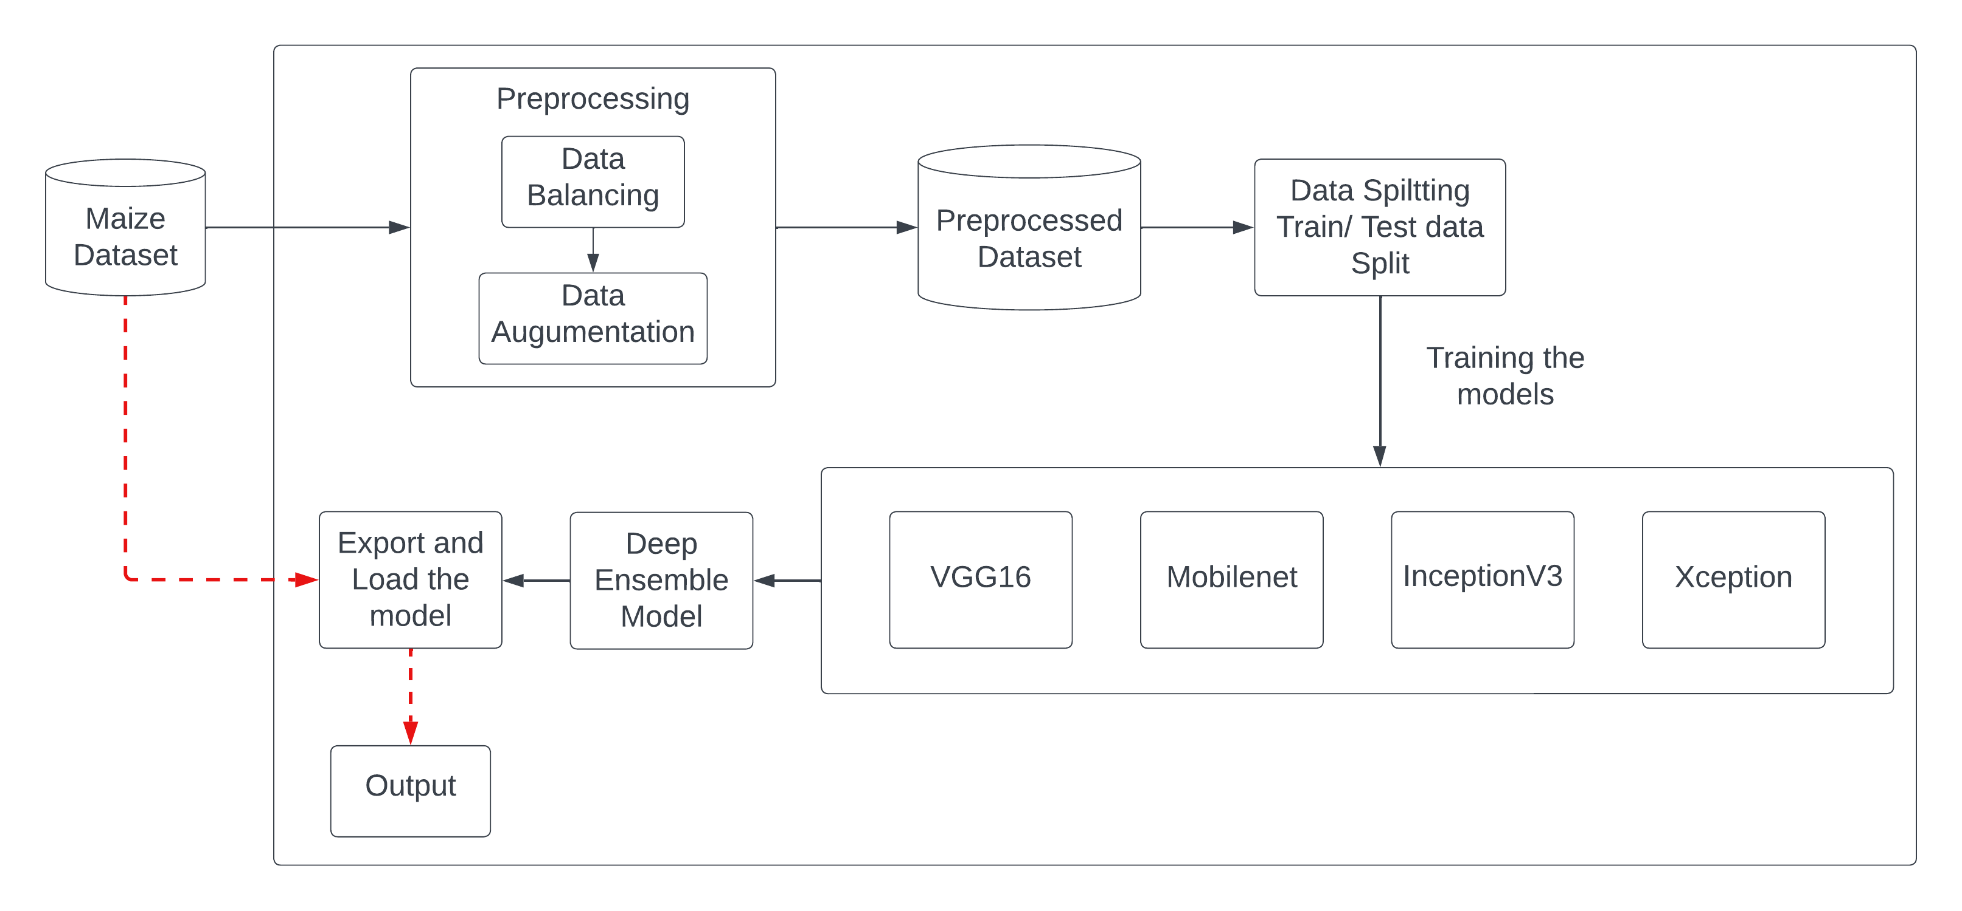
Architecture / Design

Slide 14
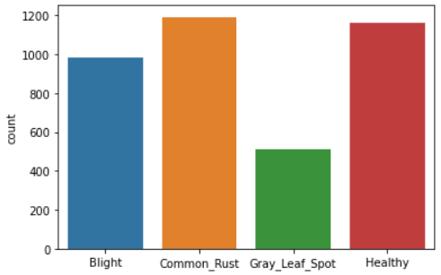
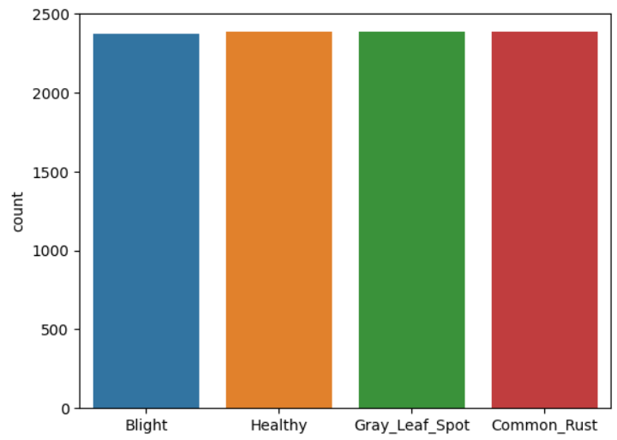
Partial Implementation
Upon visualizing the dataset, we discovered that the dataset was unbalanced and smaller
Augmentation of data is done to get a larger number of images
The augmented dataset was then split into three sets: train, validation, and test sets, using an 80:10:10 ratio.
Several pre-trained CNN models were trained on the dataset, including VGG16, Mobilenet, Inceptionv3, and Xception.

Slide 15
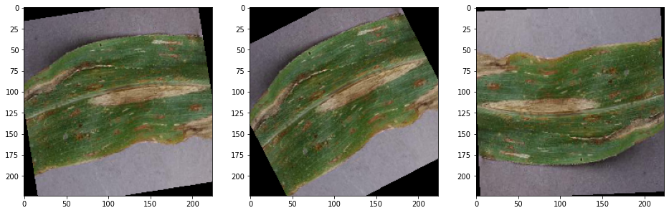
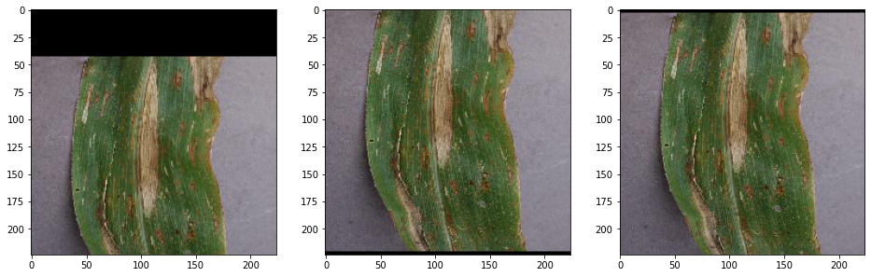
Data Pre-Processing

Slide 16
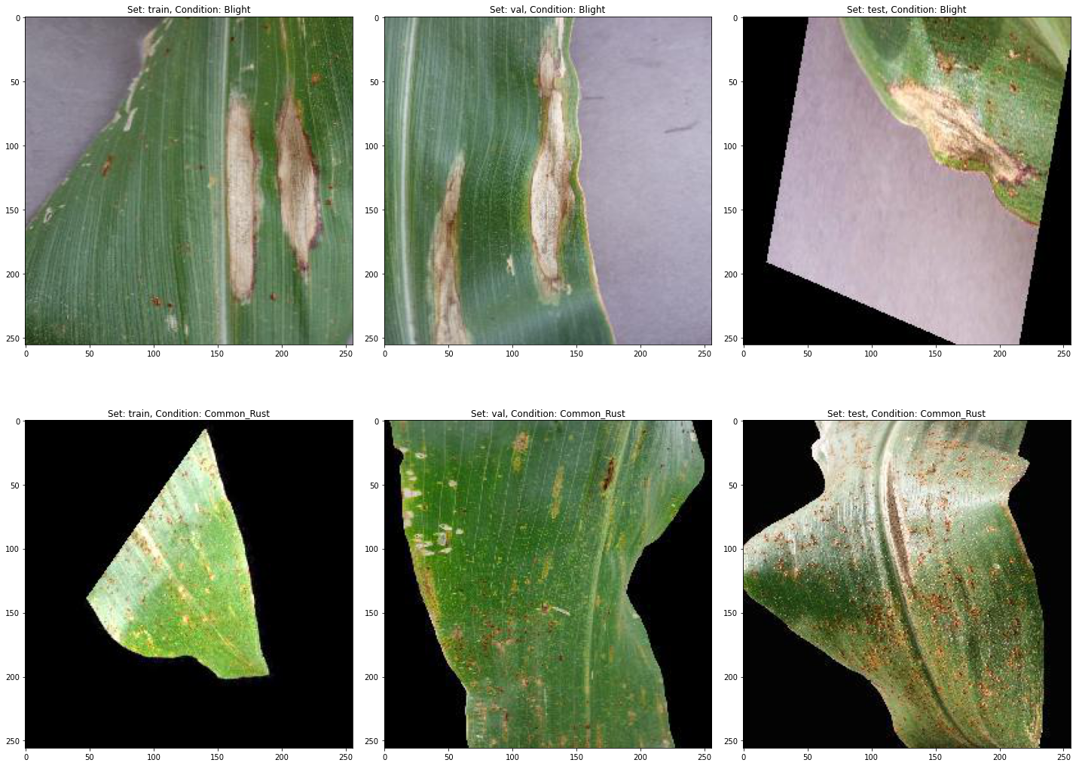
Data Pre-Processing

Slide 17
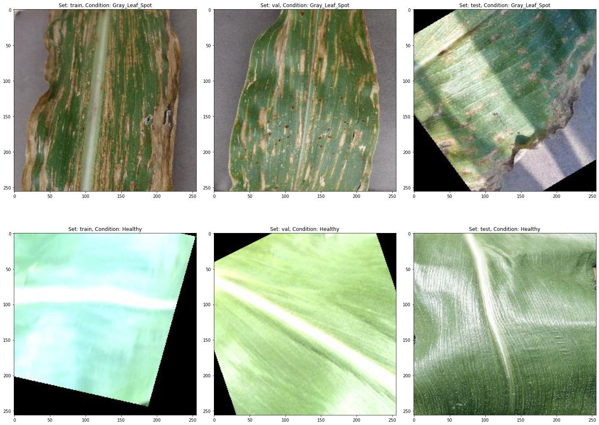
Data Pre-Processing

Slide 18
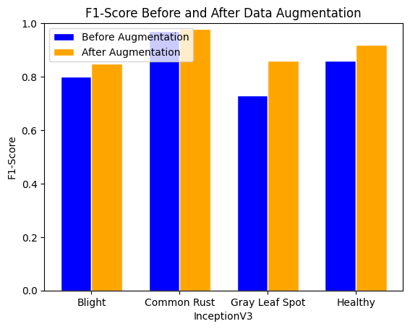
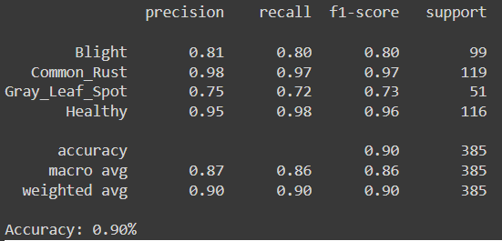
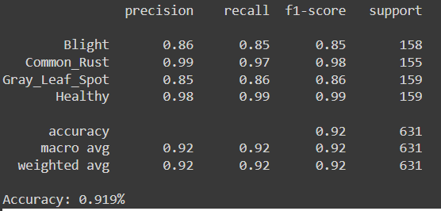
InceptionV3

Slide 19
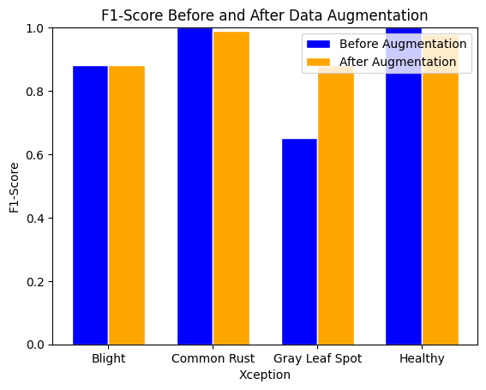
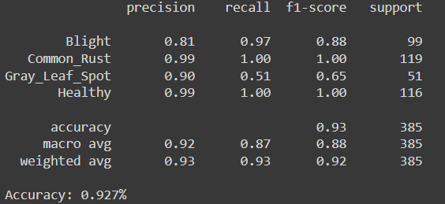
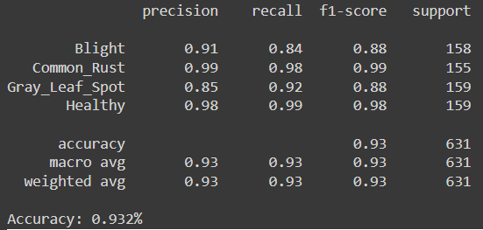
Xception

Slide 20
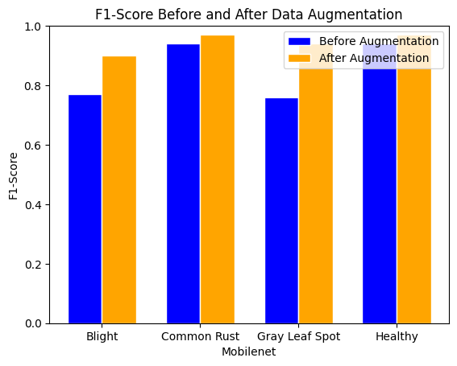
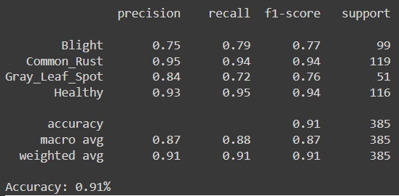
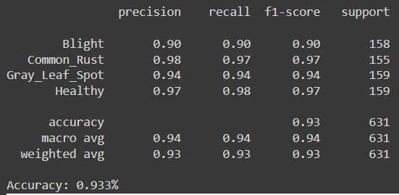
Mobilenet

Slide 21
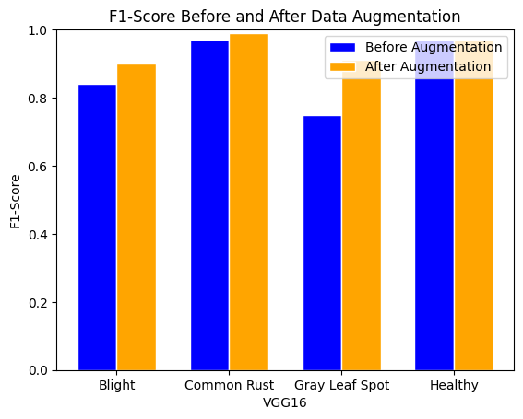
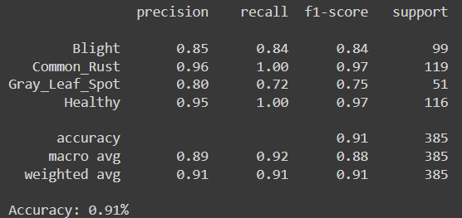
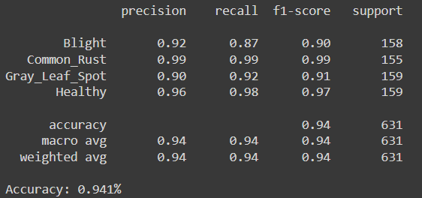
VGG

Slide 22
Why Ensemble
Ensemble learning can improve the generalization performance of models by reducing overfitting.

Slide 23
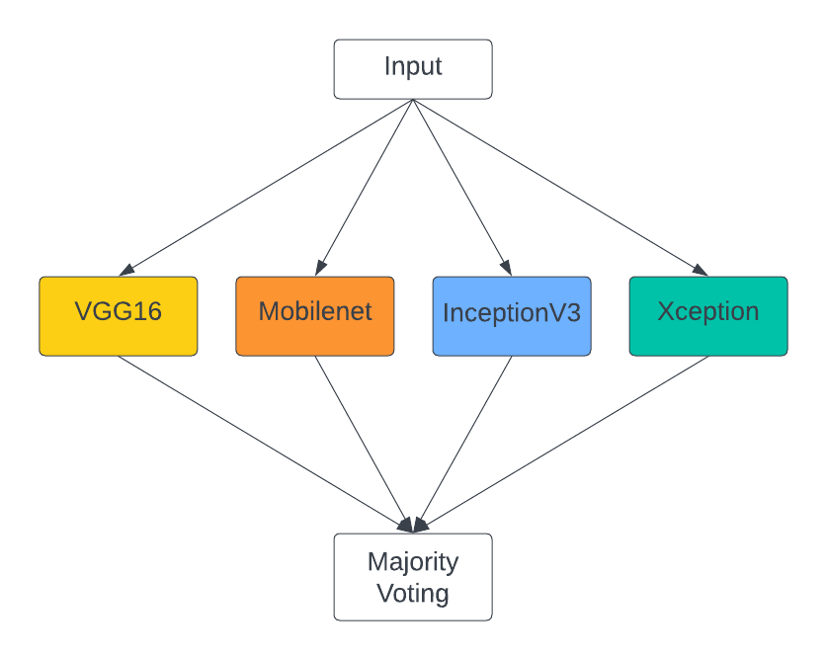
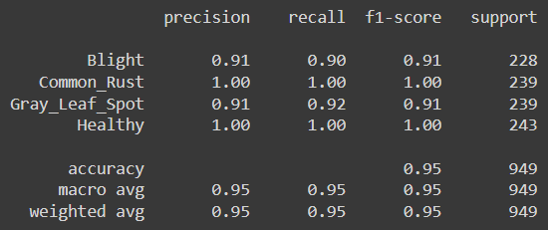
Ensemble Techniques

Slide 24

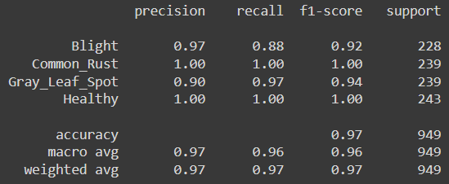
Ensemble Techniques

Slide 25

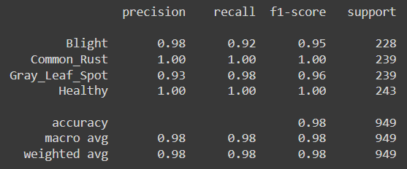
Ensemble Techniques

Slide 26
Conclusion
In conclusion, that deep ensemble learning strategies have the potential to considerably increase the accuracy of corn leaf disease classification.
The four deep learning models (VGG16, MobileNet, InceptionV3, and Xception) all exhibited good performance on the dataset, with accuracy ranging from 90% to 92% when using the data before augmentation and 91% to 94% when using the data after augmentation respectively.
Additionally, the deep ensemble techniques that were utilized in this work (model averaging ensemble and weighted averaging ensemble) considerably increased the classification accuracy, obtaining an accuracy of 96.5% and 97.6%, respectively, in the process.

Slide 27
References
Z. Liu, Z. Du, Y. Peng, M. Tong, X. Liu and W. Chen, "Study on Corn Disease Identification Based on PCA and SVM," 2020 IEEE 4th Information Technology, Networking, Electronic and Automation Control Conference (ITNEC), Chongqing, China, 2020, pp. 661-664, doi: 10.1109/ITNEC48623.2020.9084689.
T. Ren, Y. Zhang and C. Wang, "Identification of Corn Leaf Disease Based on Image Processing," 2019 2nd International Conference on Information Systems and Computer Aided Education (ICISCAE), Dalian, China, 2019, pp. 165-168, doi: 10.1109/ICISCAE48440.2019.221610.
H. Yu et al., "Corn Leaf Diseases Diagnosis Based on K-Means Clustering and Deep Learning," in IEEE Access, vol. 9, pp. 143824-143835, 2021, doi: 10.1109/ACCESS.2021.3120379.
W. Agustiono, "An ensemble-of-classifiers approach for corn leaf based diseases detection," 2021 IEEE 7th Information Technology International Seminar (ITIS), Surabaya, Indonesia, 2021, pp. 1-6, doi: 10.1109/ITIS53497.2021.9791825.
W. Wenxuan, W. Qianshu, H. Chaofan, S. Xizhe, B. Ruiming and T. T. Toe, "Leaf Disease image classification method based on improved convolutional neural network," 2022 IEEE International Conference on Industry 4.0, Artificial Intelligence, and Communications Technology (IAICT), BALI, Indonesia, 2022, pp. 210-216, doi: 10.1109/IAICT55358.2022.9887392.
A. Baliyan, V. Kukreja, V. Salonki and K. S. Kaswan, "Detection of Corn Gray Leaf Spot Severity Levels using Deep Learning Approach," 2021 9th International Conference on Reliability, Infocom Technologies and Optimization (Trends and Future Directions) (ICRITO), Noida, India, 2021, pp. 1-5, doi: 10.1109/ICRITO51393.2021.9596540.

Slide 28
THANK YOU

